Slide 1
Open source, from Microsoft with Love Almir Vuk

Slide 2
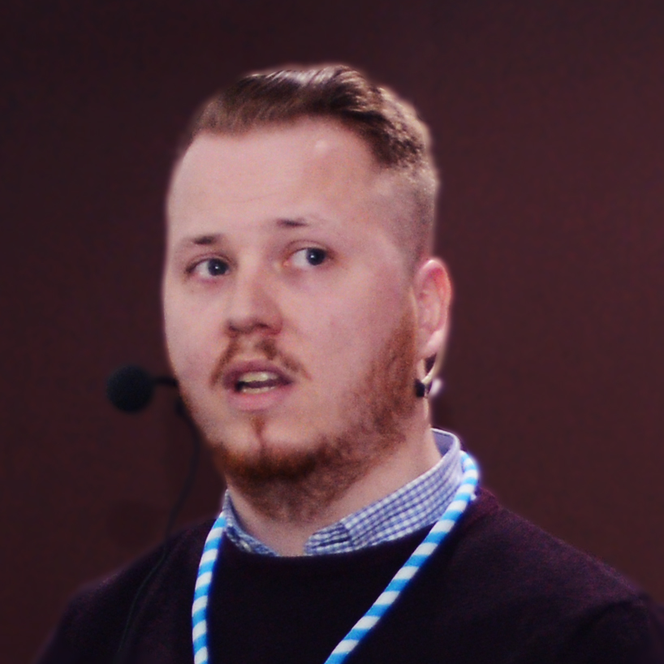

About me
Almir Vuk
.NET Developer
DEV Blogger/Speaker
Microsoft Student Partner
Student FIT-a
Programming since 2011
almirvuk.blogspot.com

Slide 3
Open source, from Microsoft with Love

Slide 4
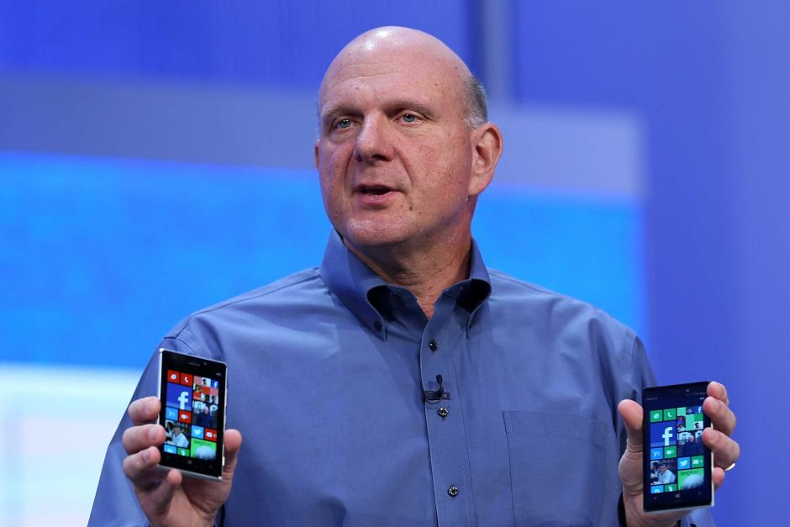
Linux is a cancer that attaches itself in an intellectual property sense to everything it touches,

Slide 5
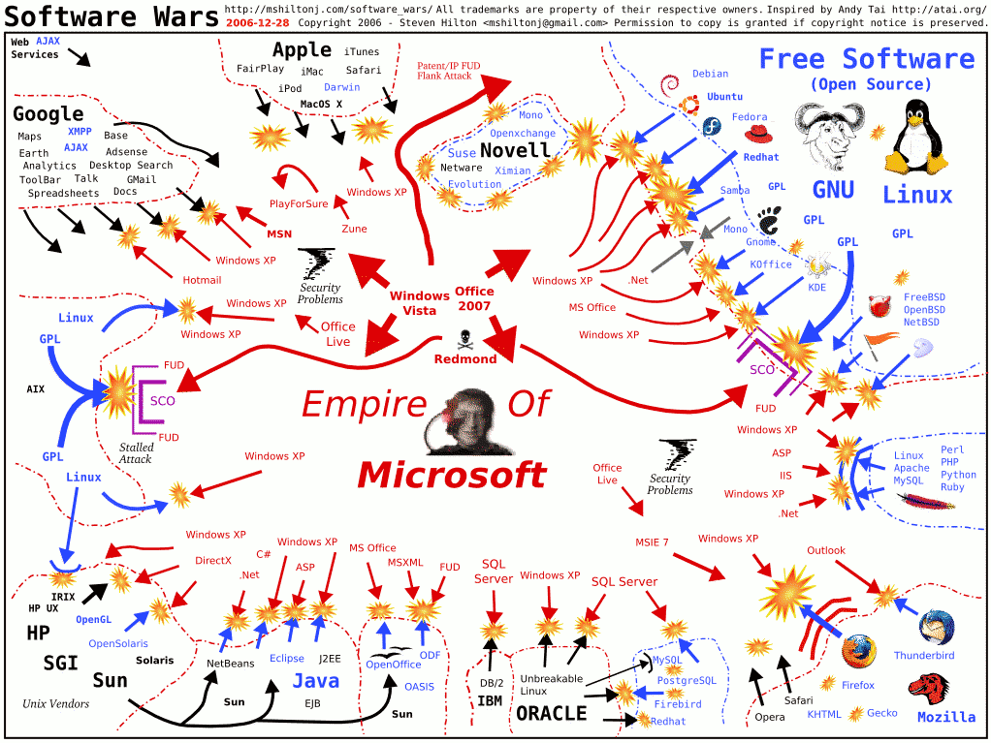

Slide 6
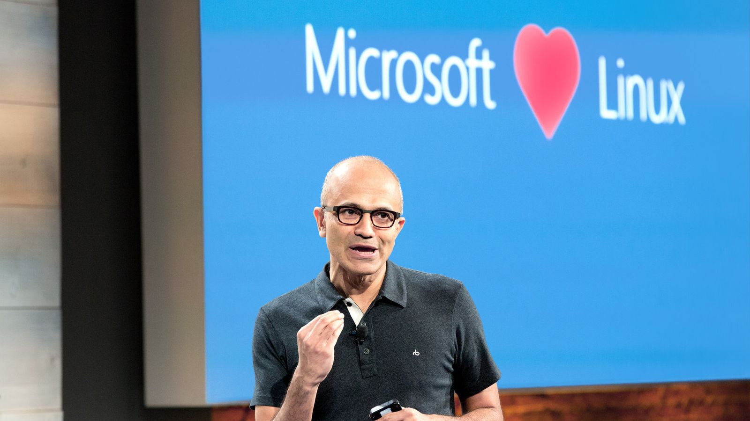
„Nearly 1 in 3 Azure virtual machines are Linux.“

Slide 7
„One reason Microsoft developers are enthusiastic about open source is because its CEO is big on open-source technology“

Slide 8
Microsoft Open Source products

Slide 9

Linux VMs on Azure
SUSE Linux Enterprise Server
openSUSE
Ubuntu Linux
Oracle Linux
CoreOS
CentOS
Kali Linux
Clear Linux OS

Slide 10
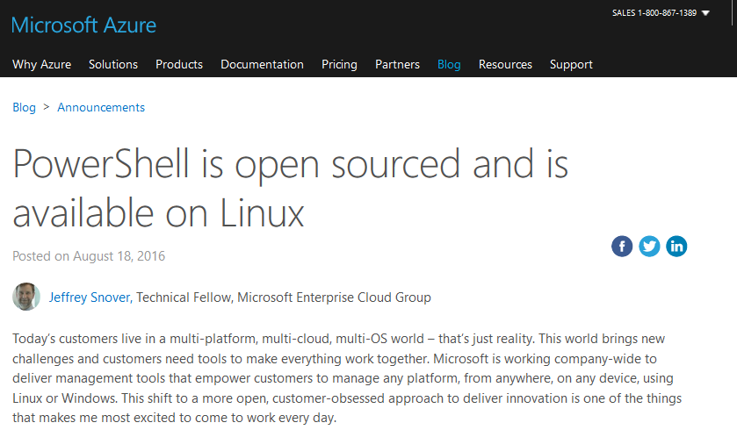
PowerShell for Linux

Slide 11
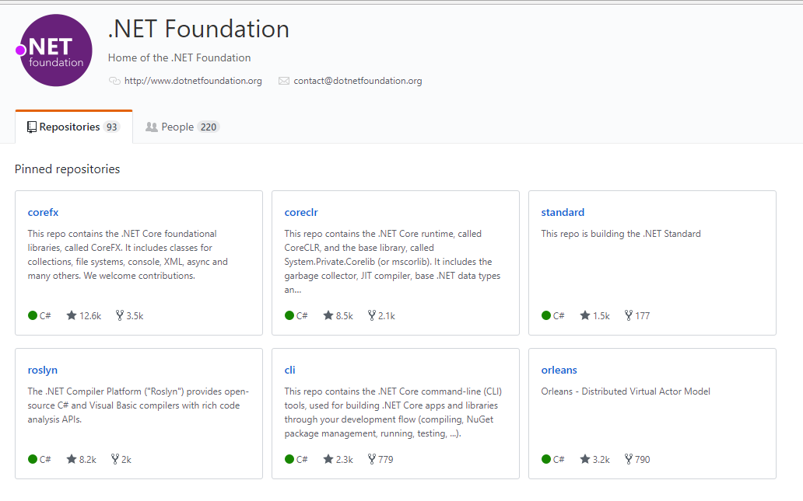
.NET Core

Slide 12
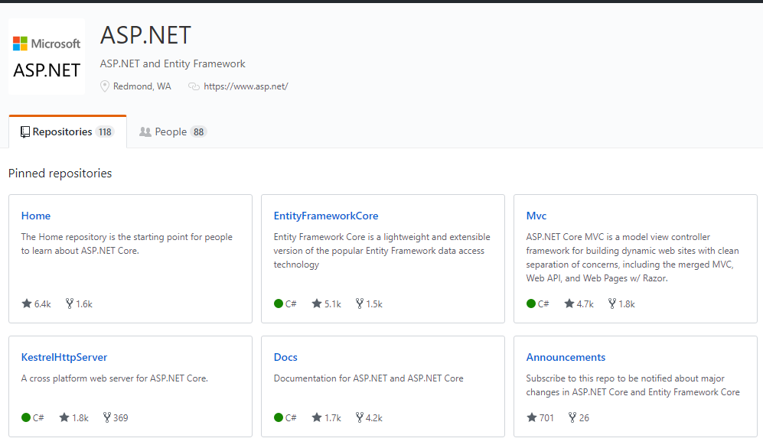
aspnet core

Slide 13
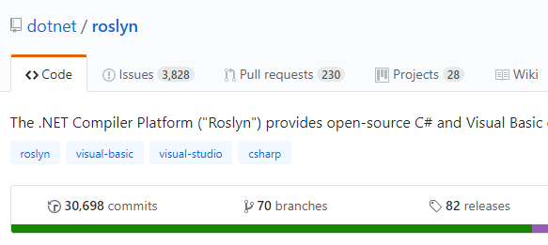
Roslyn

Slide 14
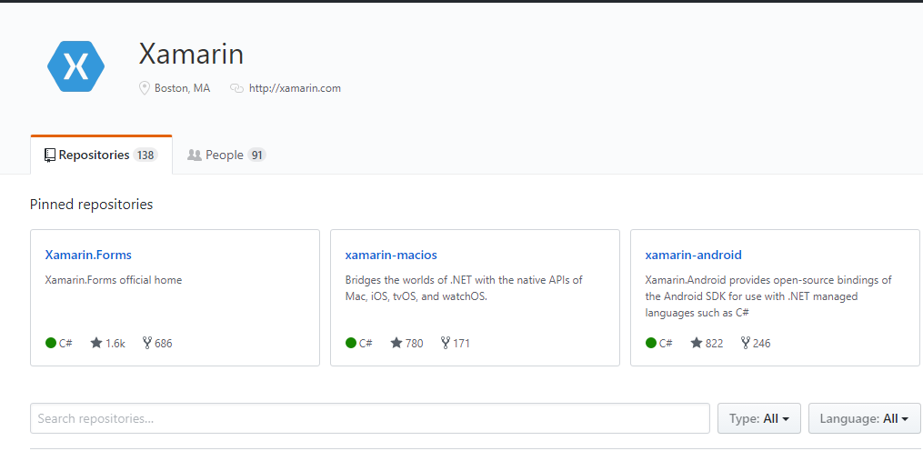
Xamarin

Slide 15

Entity Framework Core

Slide 16
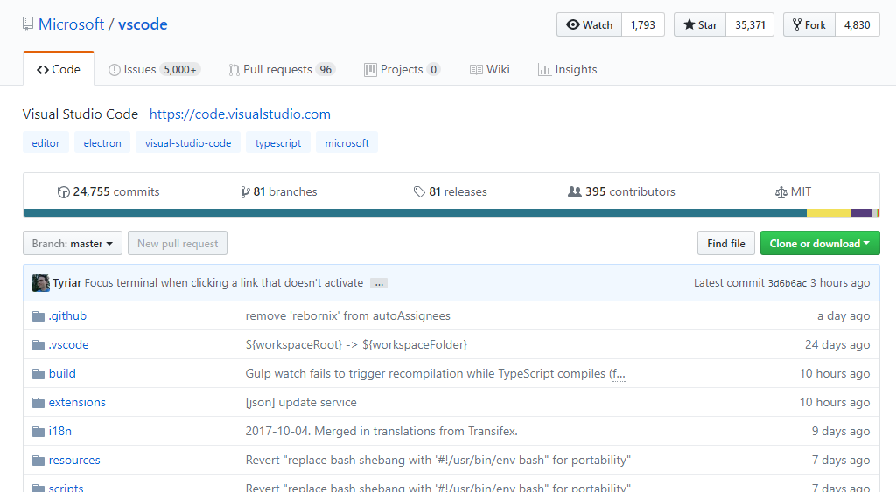
Visual Studio Code

Slide 17
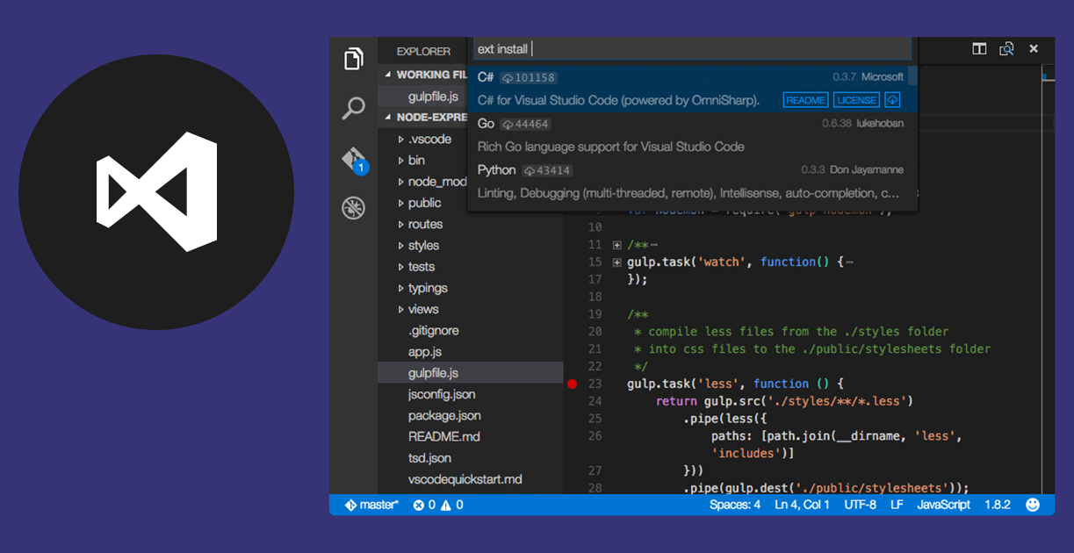
Visual Studio Code

Slide 18
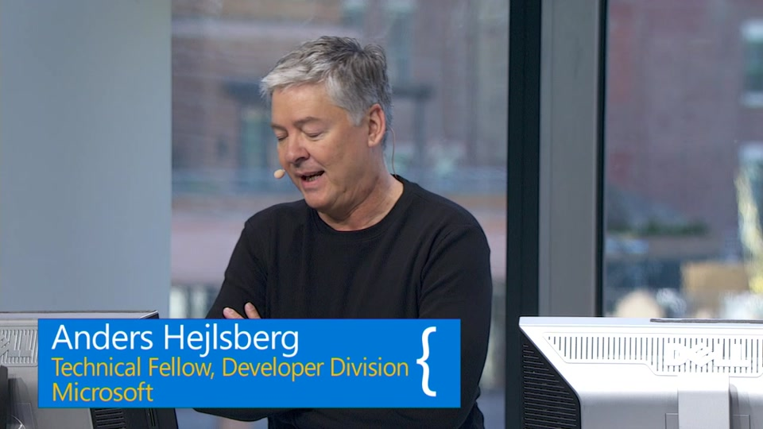
TypeScript

Slide 19
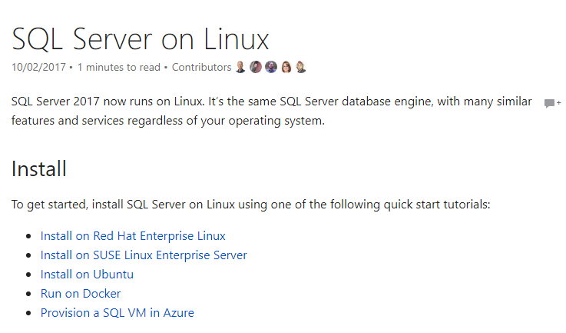
SQL Server

Slide 20

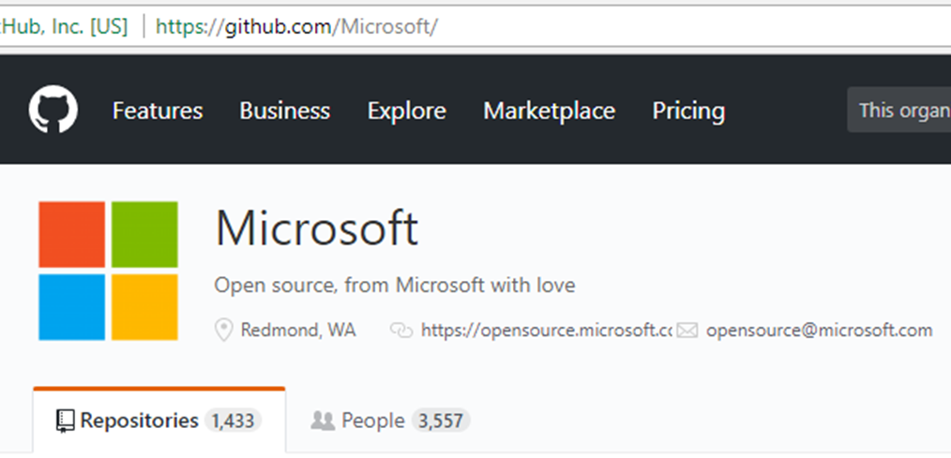
Codeplex & GitHub

Slide 21
Do pull request!

Slide 22
I’m not sure Microsoft has achieved the position and legitimacy in regards to open source that they obviously desire to achieve but they are in a far better position today than they have ever been before.

Slide 23
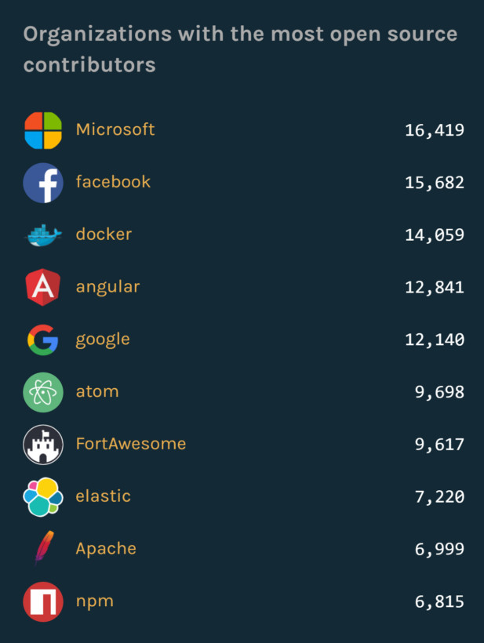

Slide 24


Microsoft ♥ Open Source Hvala vam na pažnji!
almirvuk.blogspot.com
almir.vuk@outlook.com
github.com/almirvuk

